Slide 1
Experimental methods for studying nanobubbles under a microscope
台大應力所
江宏仁 Hong-Ren Jiang

Slide 2
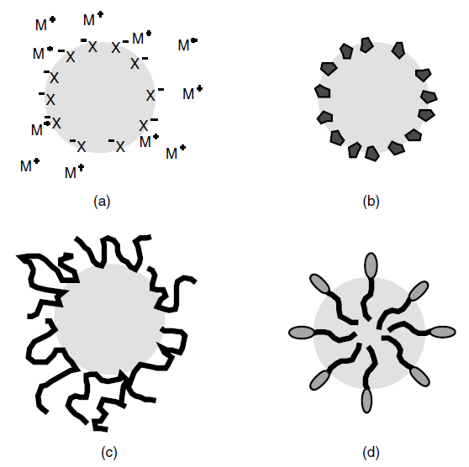
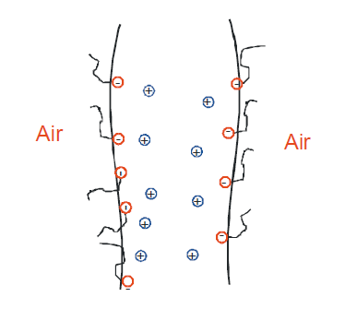
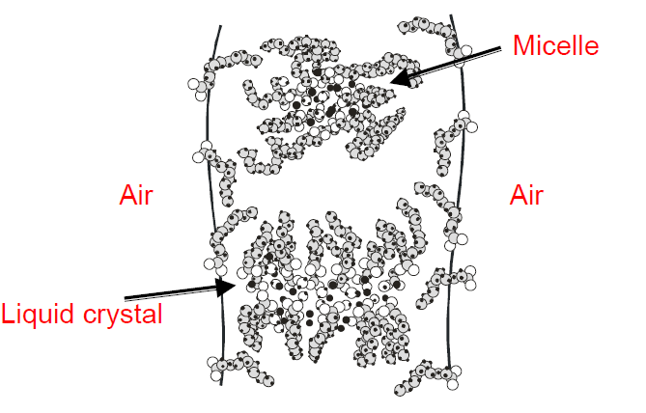
Micro-/nano bubbles as colloids
Equilibrium properties
Brownian motion
Adsorptions
Interactions and stability
Van der Waals force?
Coulombic repulsion
Depletion or entropy hindrance

Slide 3
Micro-/nano bubbles as colloids
Dynamical properties (under external fields)
Electrophoresis
Dielectrophoresis
Thermophoresis
Diffusiophoresis

Slide 4
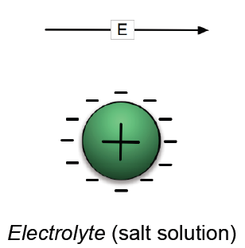

What is phoresis : electrophoresis as an example
Body force
Electro-osmossis
interfacial force

Slide 5
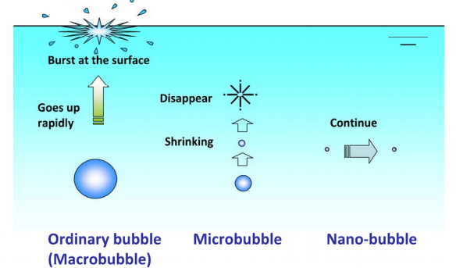
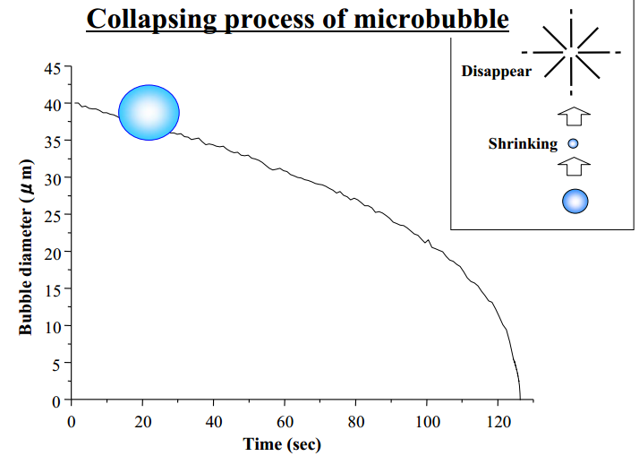
How to study micro/nano bubbles?
From Dr.Masayoshi Takahashi’s
presentation

Slide 6
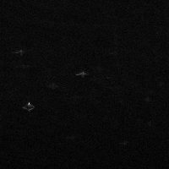
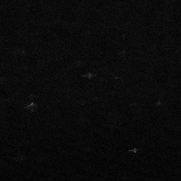
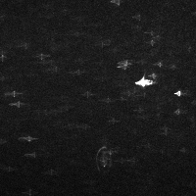
Laser sheet dark field for studying bubble generation
motor
Laser sheet
Laser
Detector
500um
Water

Slide 7
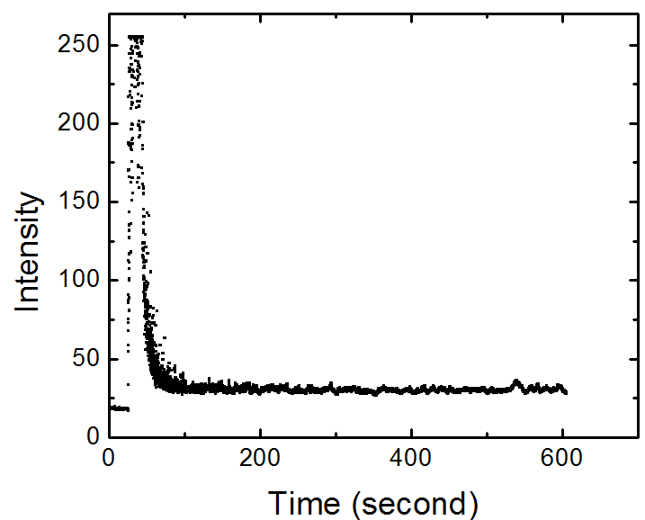
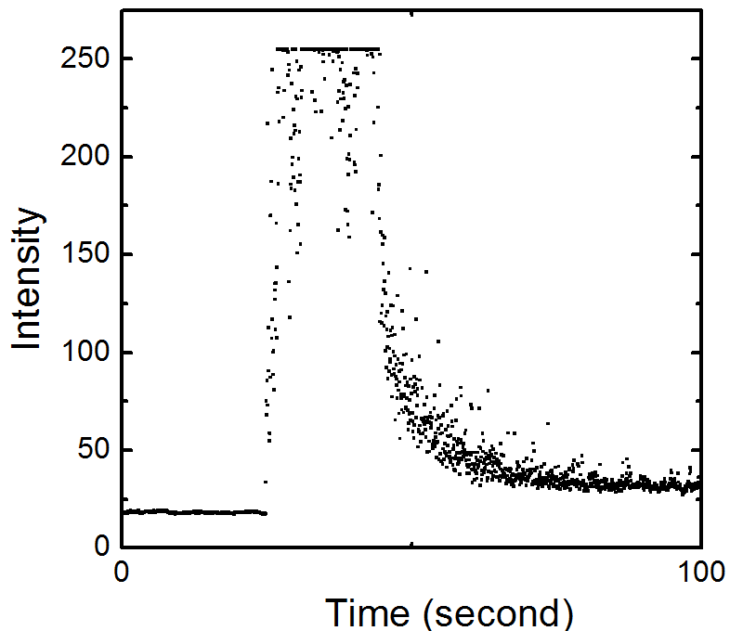
water

Slide 8
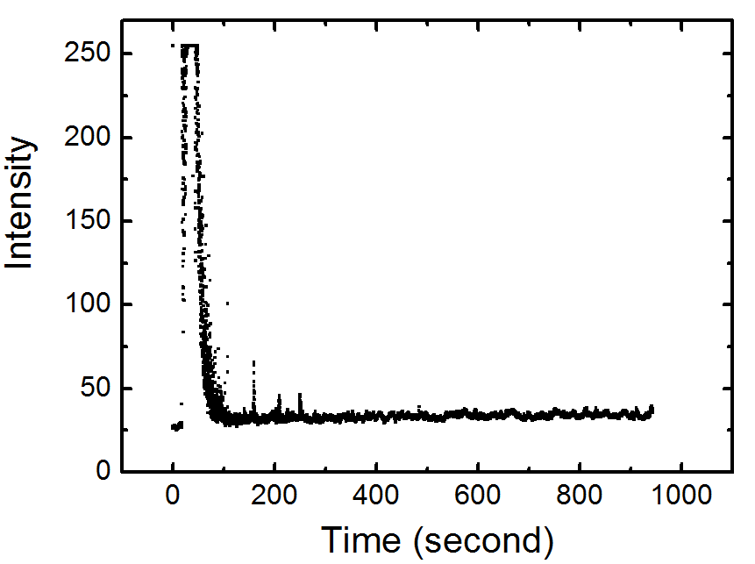
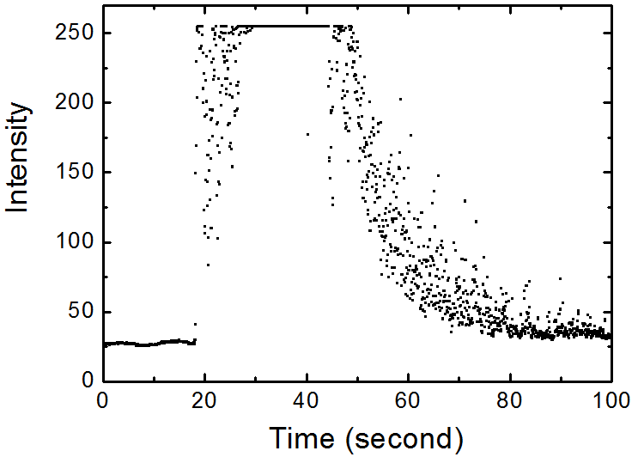
0.9% NaCl

Slide 9
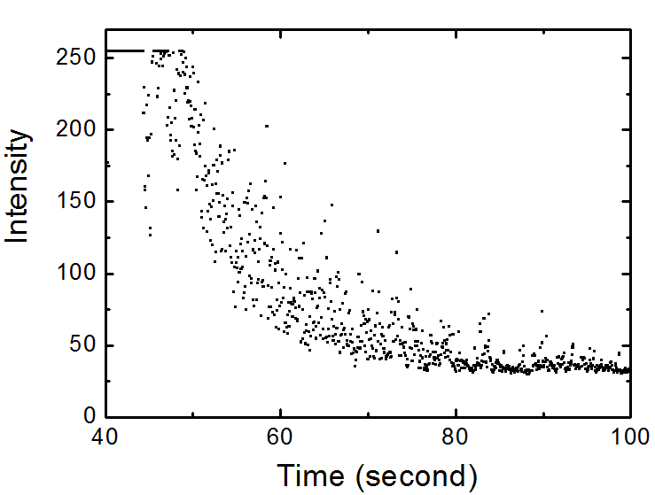
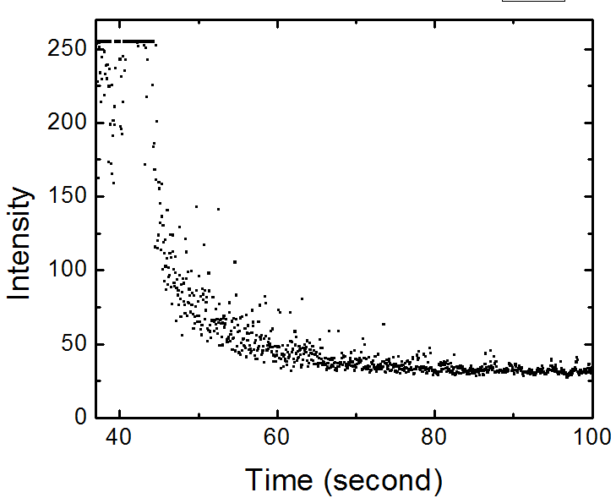
0.9% NaCl
water

Slide 10
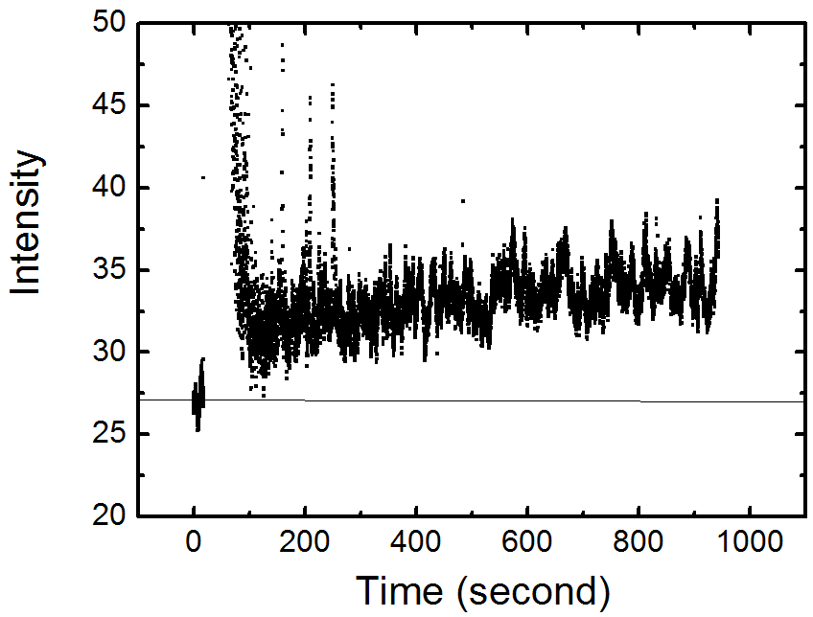
0.9% NaCl

Slide 11
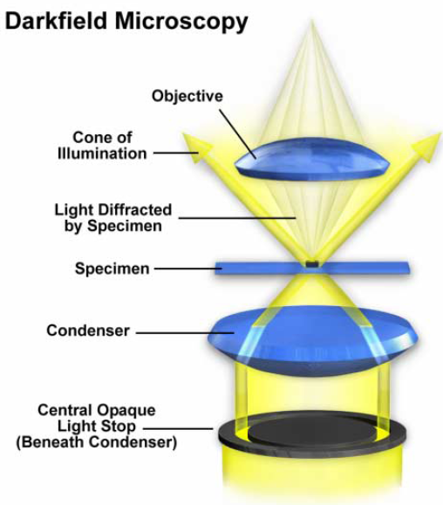
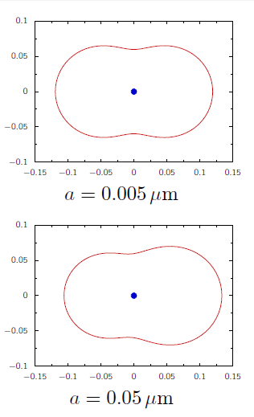
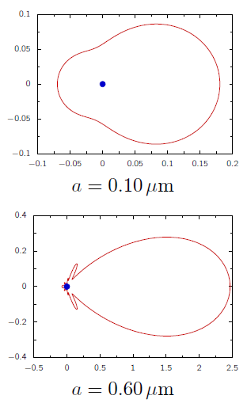
Dark field microscope for bubble dynamics
Our setup
20’
37’

Slide 12
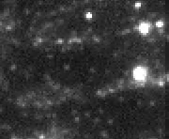
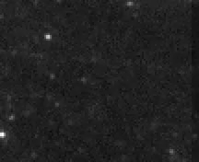
Test for dark field microscope
200 nm PS particle
100 nm PS particle
100um

Slide 13
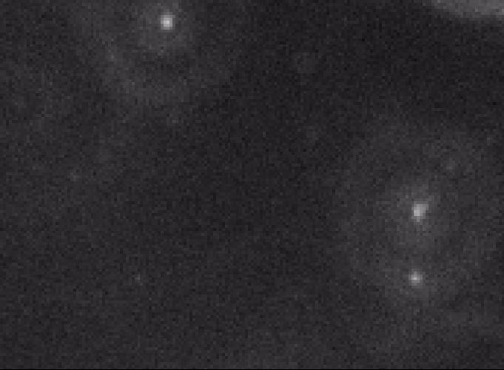
Bubbles in 0.9% NaCl
100um
Problems
Glass surface
CCD sensitivity
10um

Slide 14
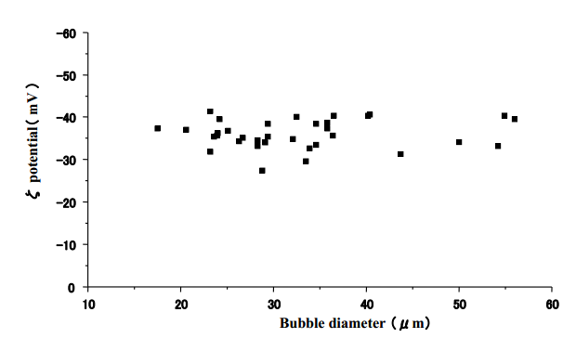
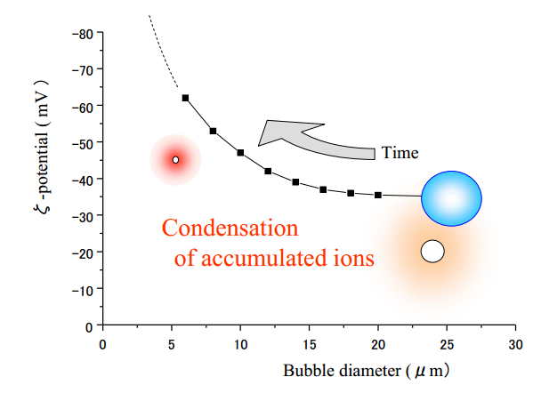
Zeta potential of microbubble
From Dr.Masayoshi Takahashi’s
presentation

Slide 15
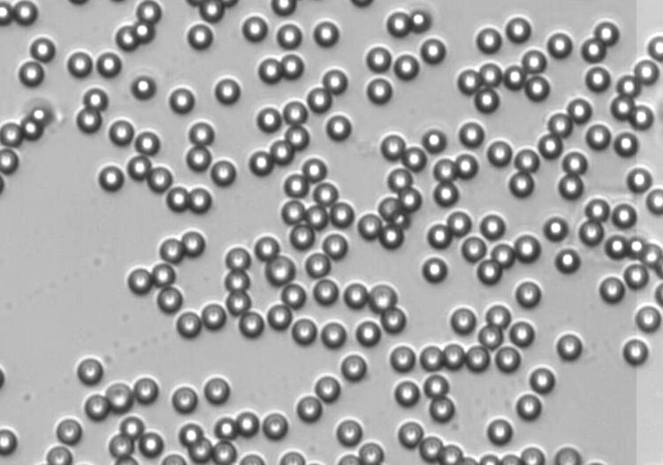
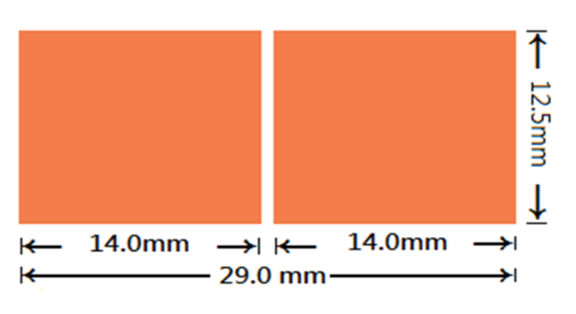
Electrophoresis and polarizations
AC or DC
Up 400Vpp 1MHz

Slide 16
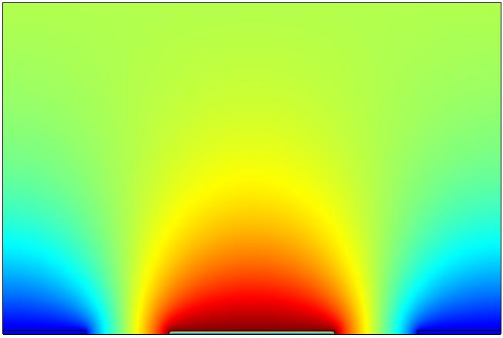
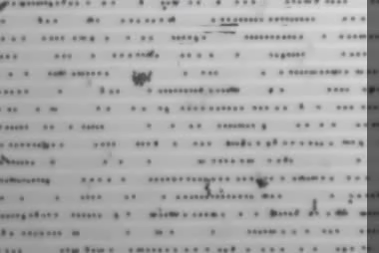
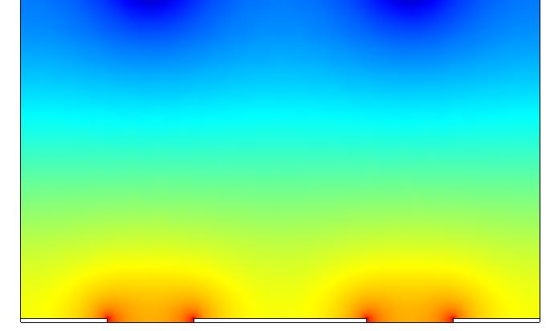
Traps for bubbles : dielectrophoresis
Electric potential
ITO
AC
10um for each electrode; 5 um space
Potential of dielectrophoresis
5KHz to 200KHz

Slide 17
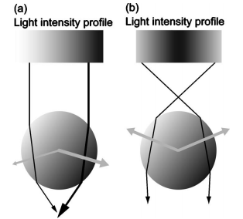
Traps for bubbles: modified optical tweezers
Ring trap for low refractive index bubble
IF n of particle > n of water
IF n of particle < n of water
2-3um

Slide 18
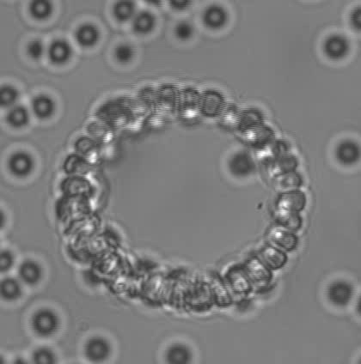
Example of ring trap

Slide 19
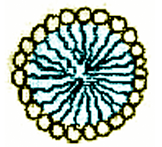
bubble and interfacial phenomena Thermophoresis in colloids in aqueous solution: moving toward low or high temperature region
Temperature
Low temperature
High temperature

Slide 20
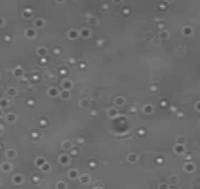
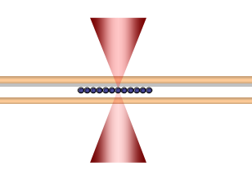
Experimental Setup - motion in thermophoresis
Silica
Negative Soret coefficient
Silica beads
prefer high temperature
m4

Slide 21
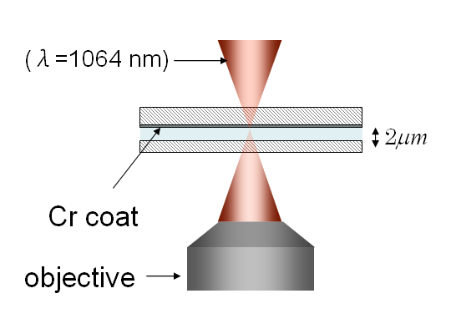
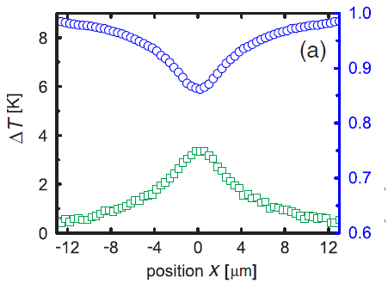
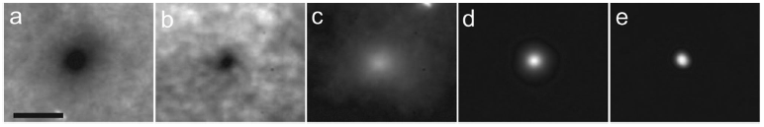
Control thermophoretic properties by polymer depletion
Optical heating setup
Temperature distribution measured by fluorescence
Jiang, H.-R., et al.,
Physical Review Letters, 2009. 102 208301
Measuring thermophoresis-
distributions of colloids in a laser heating cell with different thermophoretic mobilities

Slide 22
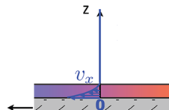
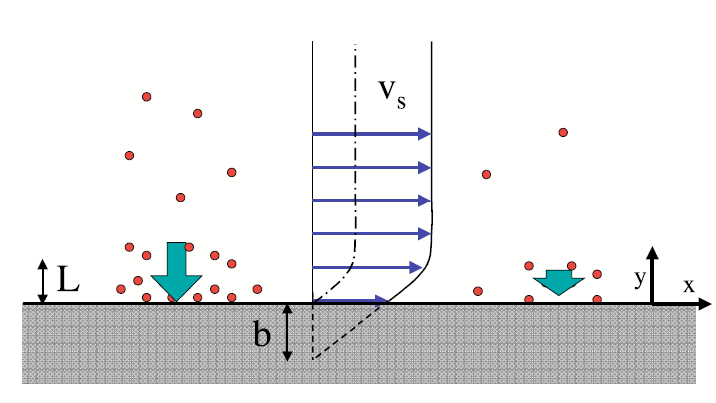
Nanobubble on colloidal interface may result partial hydrodynamic slip in thermophoresis
Phoresis and osmosis-
Interfacial force driving phenomena
T
phoresis
?
?
?
?
?
osmosis
?
Thermophoresis
Ajdari, A. and L. Bocquet,
Physical Review Letters, 2006. 96 186102.
no-slip boundary case
nanobubble on colloidal interface
Hydrodynamic partial
slip boundary case

Slide 23
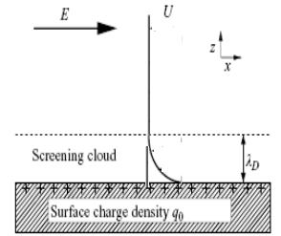
Interfacial force and flow
Gradient
Interfacial layer

Slide 24
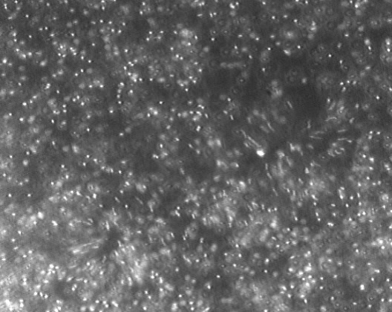
Thermo-osmosis and partial hydrodynamic slip

Slide 25
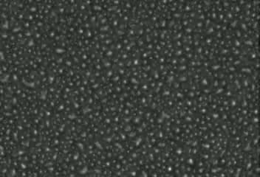
Superhydrophobic surface
Water w/o bubble
Superhydrophobic surface

Slide 26
Thank you!

Slide 27


